Slide 1
NUCLEAR AND QUANTUM PHYSICS

Slide 2
E Nuclear and Quantum Physics
E.1 Structure of The Atom
E.2 Quantum Physics
E.3 Radioactive Decay
E.4 Fission
E.5 Fusion and Stars

Slide 3
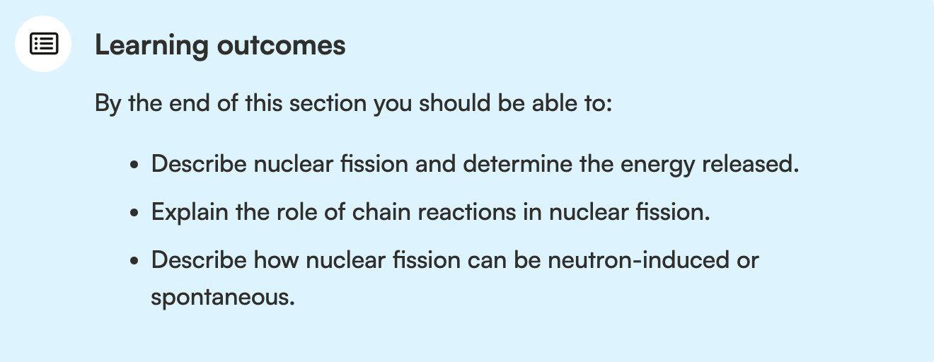
E Nuclear and Quantum Physics
E.1 Structure of The Atom
E.2 Quantum Physics
E.3 Radioactive Decay
E.4 Fission
E.5 Fusion and Stars

Slide 4
Energy released through
Radioactive Decay
Nuclear Fission
Nuclear fusion
where binding energy is the source of energy released.
This can be calculated through i.) mass defect or ii.) binding energy per nucleon.

Slide 5
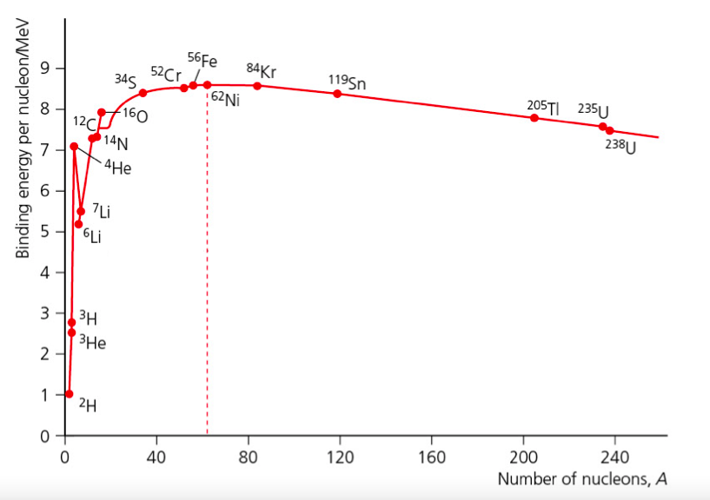
Variations in Nuclear Stability:
Fission and Fusion

Slide 6
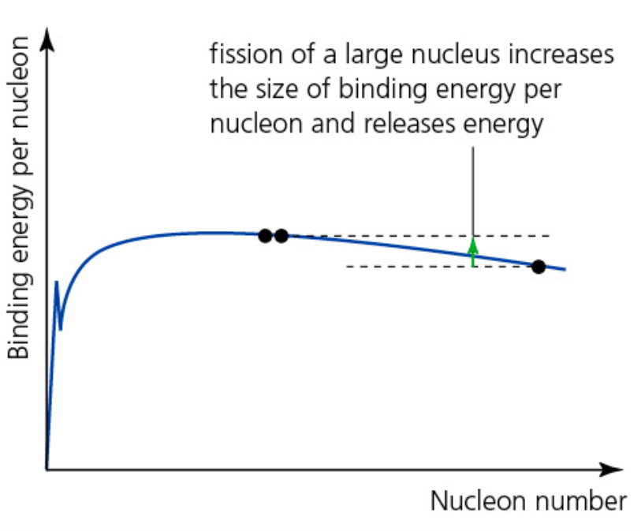
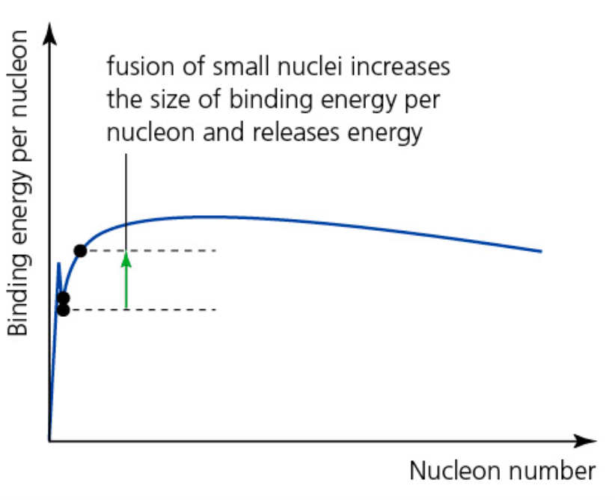

Nuclear Stability
Nuclear fission
Nuclear fusion

Slide 7
Nuclear Fission
Nuclear fission
Spontaneous fission: very very rare, for example in the Earth’s crust
Neutron-induced fission: a neutron is made to interact with a heavy nucleus to produce a new unstable isotope of the original nucleus

Slide 8
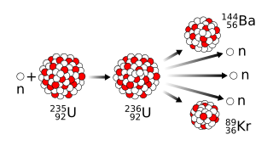
Neutron-induced Fission
Thanks to the emission of neutrons, the neutron-induced reaction can continue to take place – called as chain reaction.

Slide 9
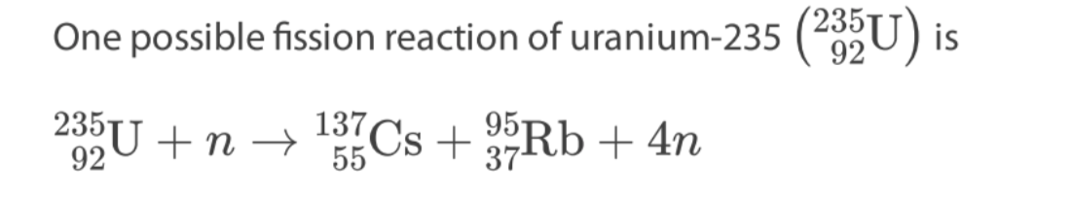
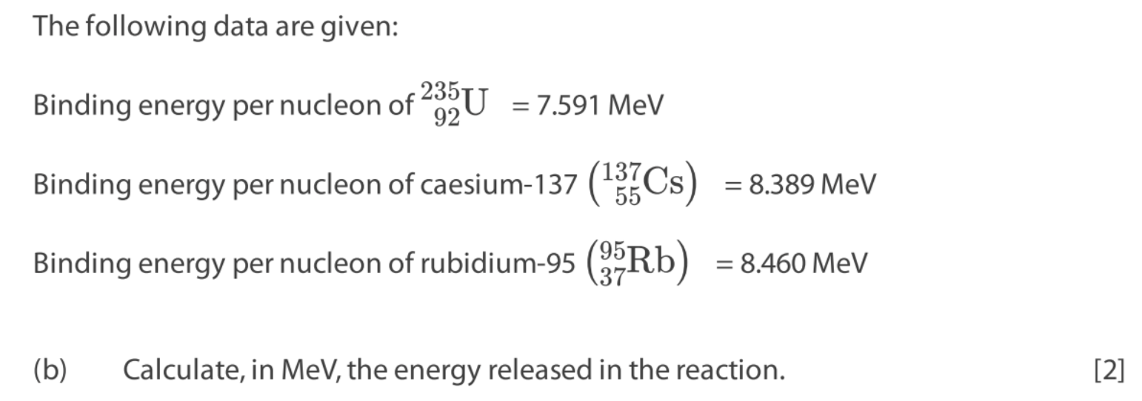
If done do paper questions E.4: 12
Notes:
C

Slide 10
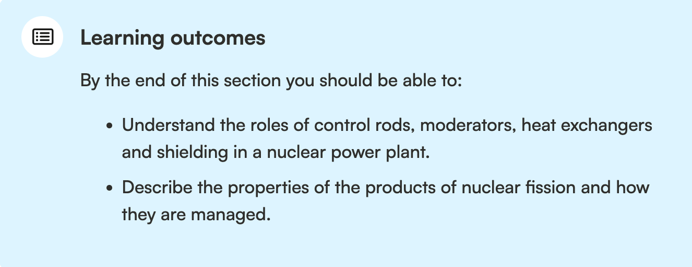
Nuclear Power Plants

Slide 11
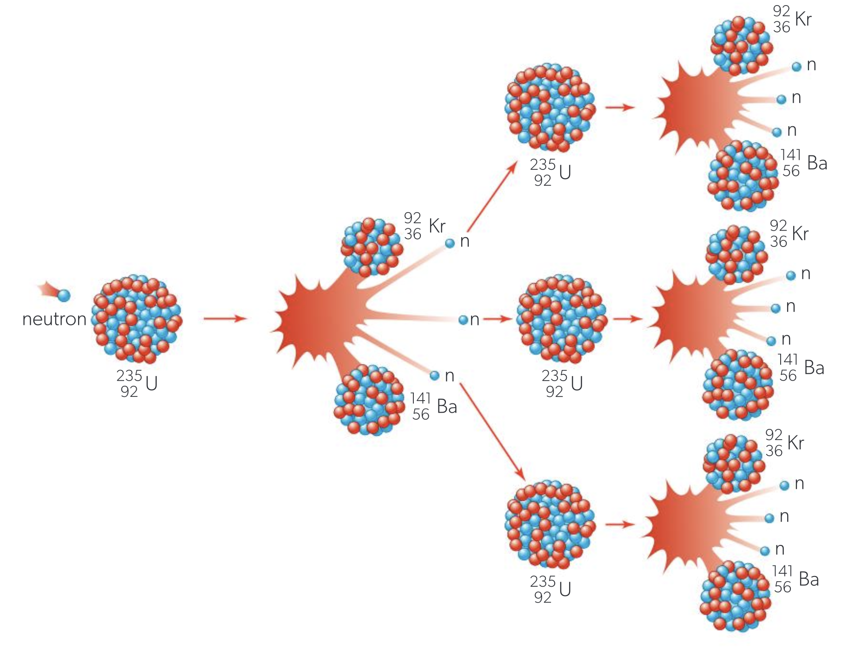
Chain Reaction
There needs to be a control mechanism to slow down the production of energy or to produce more.

Slide 12
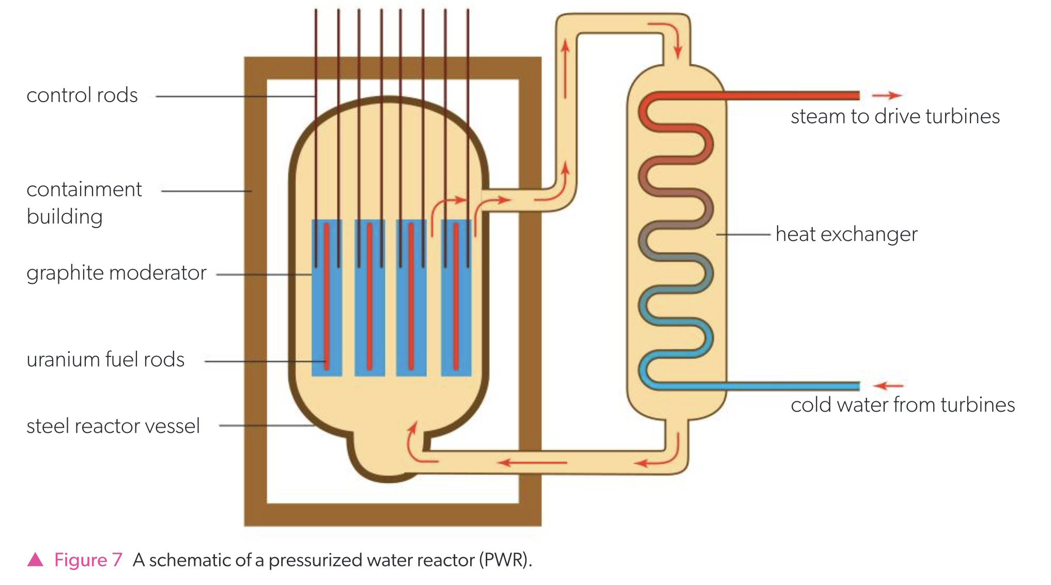
Nuclear Power Plants

Slide 13
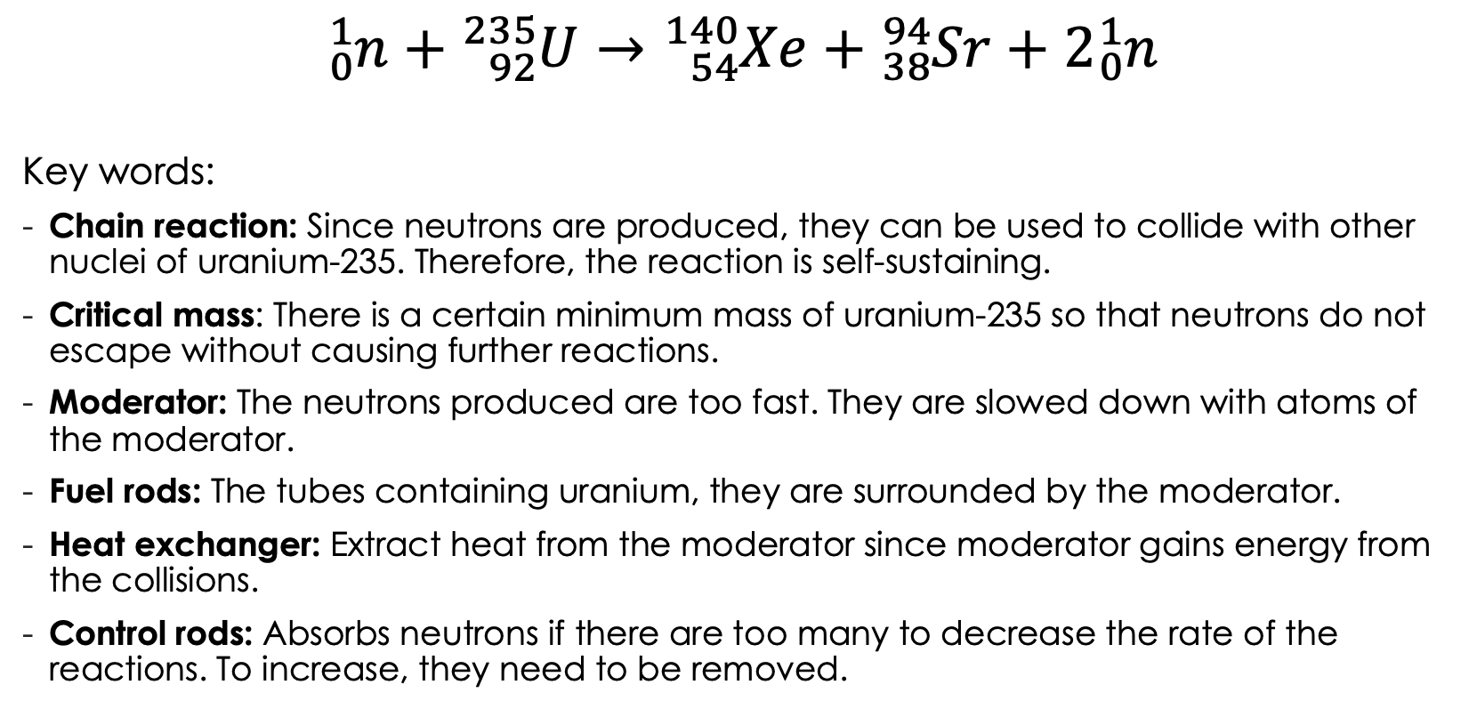
Fission Reaction

Slide 14
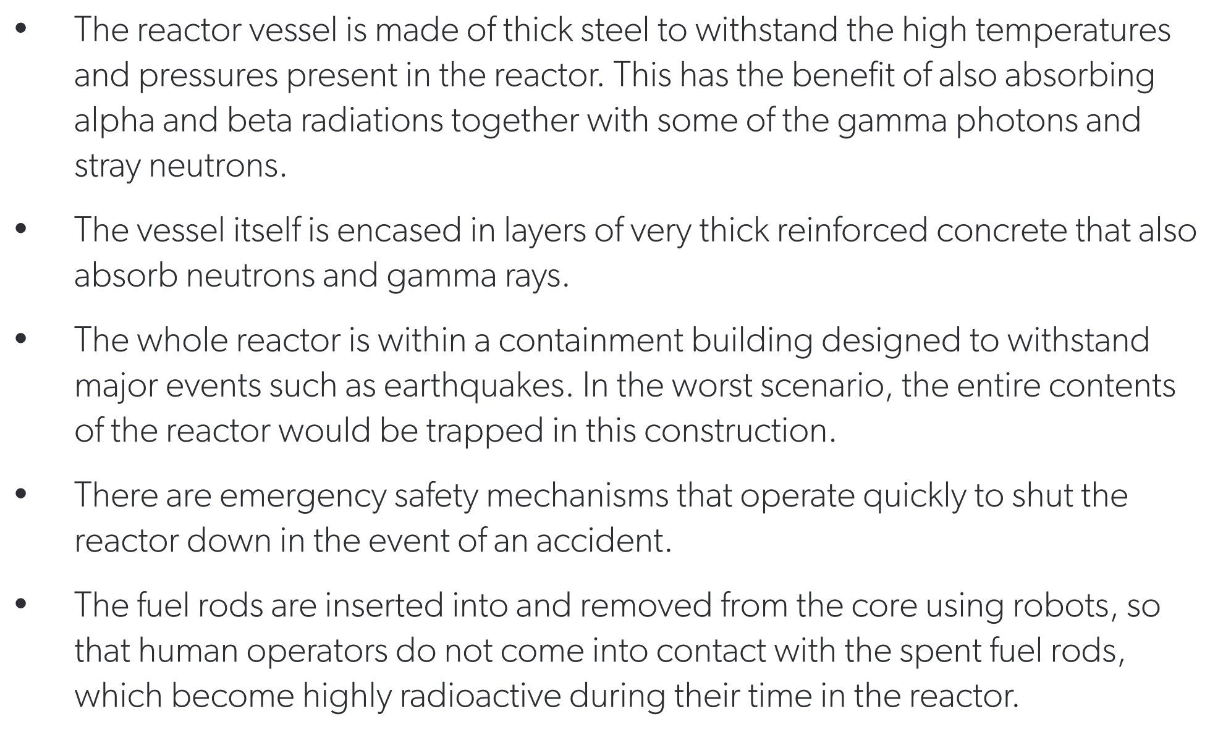
Nuclear Power Plants

Slide 15
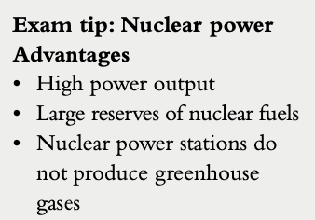
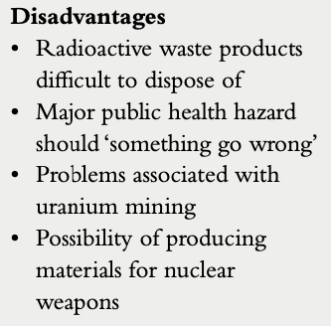
Nuclear Power Plants

Slide 16
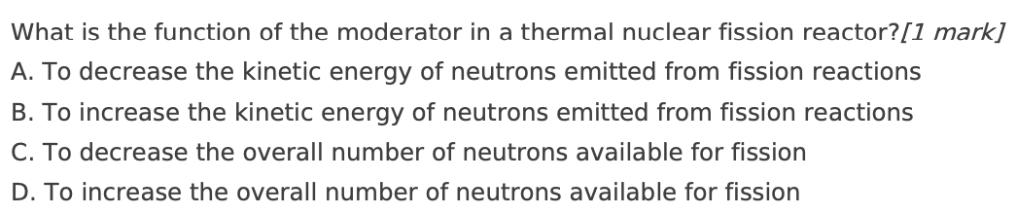
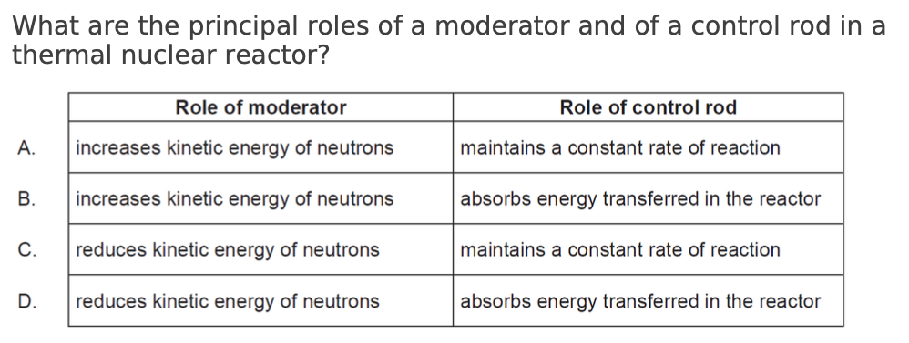
If done do paper questions E.4: 1 until 4 and 7
Notes:
C

Slide 17
E Nuclear and Quantum Physics
E.1 Structure of The Atom
E.2 Quantum Physics
E.3 Radioactive Decay
E.4 Fission
E.5 Fusion and Stars

Slide 18
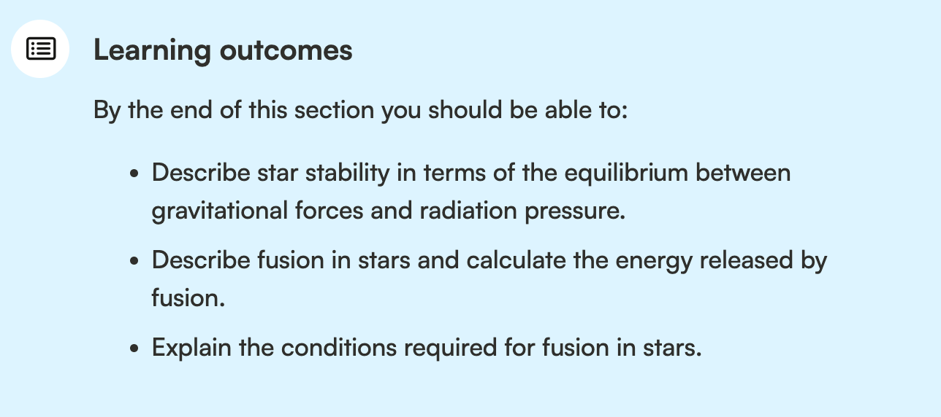
E.5 Fusion and Stars
1 Fusion
2 Stars: The Hertzprung – Russell (HR) Diagram and Stellar Evolution
3 Astronomical Distances and Parallax Method

Slide 19
Energy is released…
Radioactive Decay
Nuclear Fission
Nuclear fusion

Slide 20
Variations in Nuclear Stability:
Fission and Fusion

Slide 21
Nuclear Stability
Nuclear fission
Nuclear fusion

Slide 22
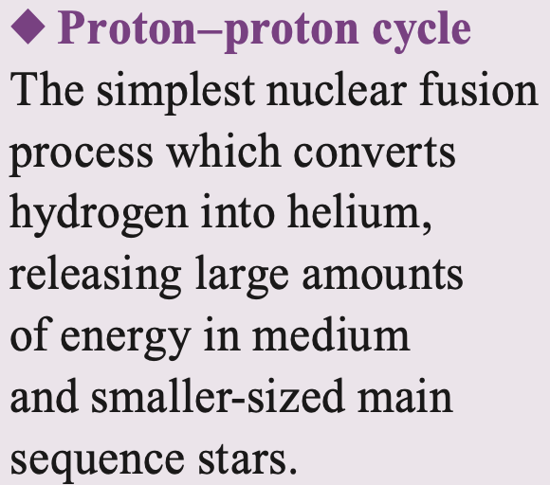
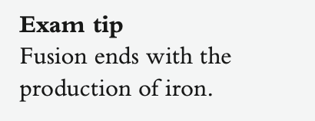
Nuclear Fusion
For fusion to occur, hydrogen nuclei must be very close together for the strong nuclear force to take effect. This requires:
  High temperature
  High density and pressure

Slide 23
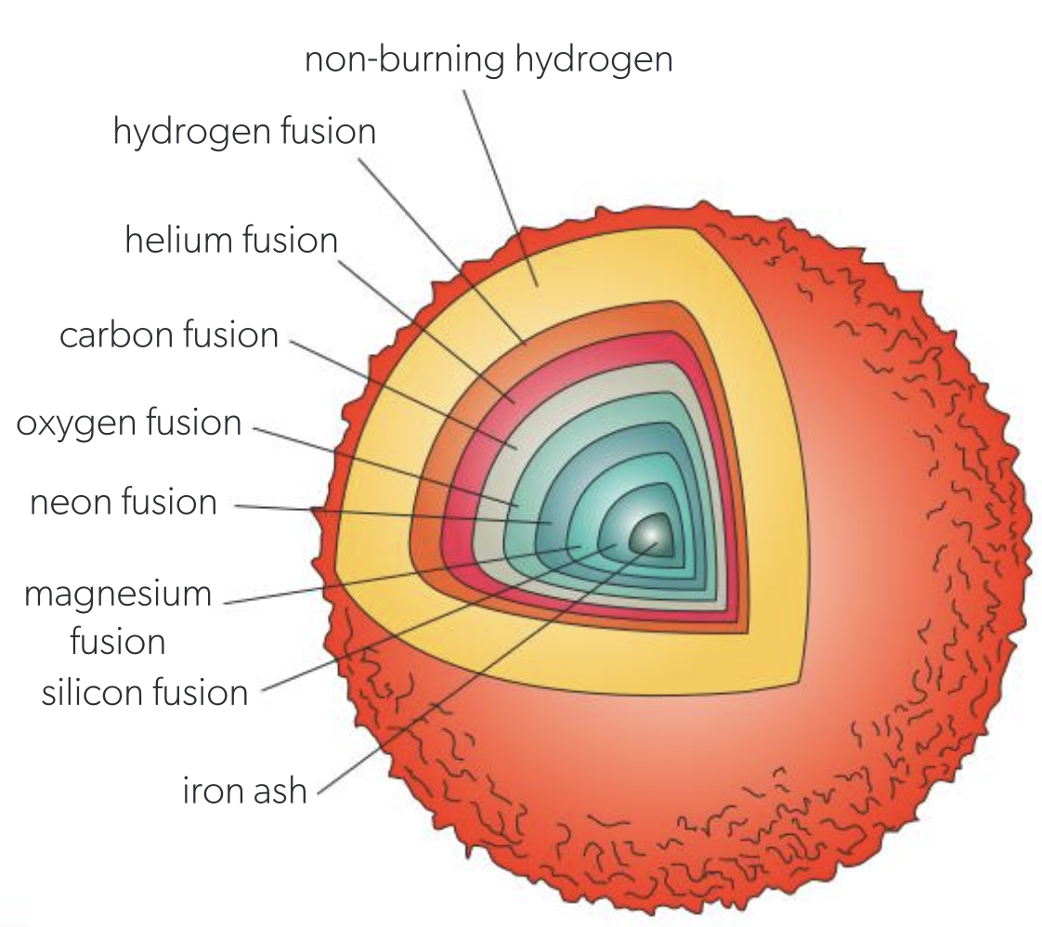
Nuclear Fusion

Slide 24
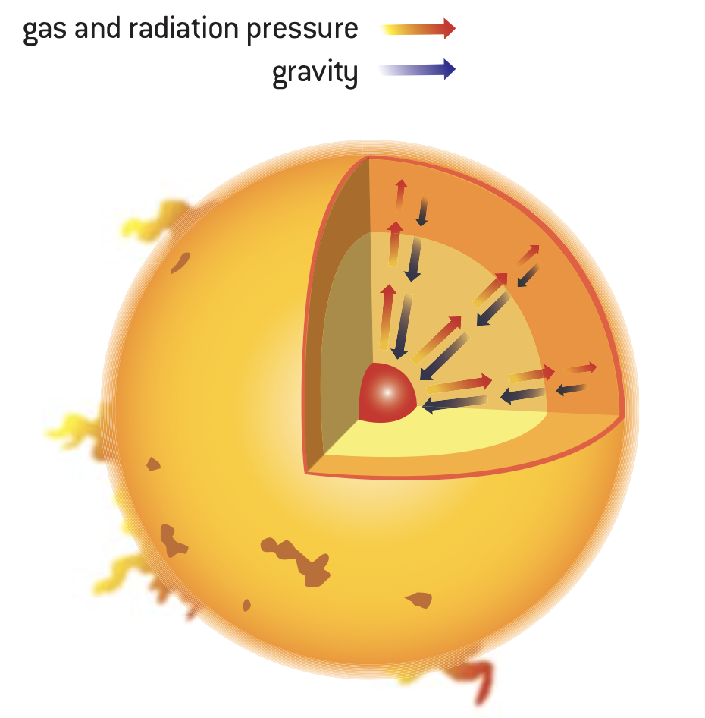
Stars
The stability of a star depends on equilibrium between two opposing forces: gravitation, which tends to collapse the star, and radiation pressure, which tends to make it expand.

Slide 25
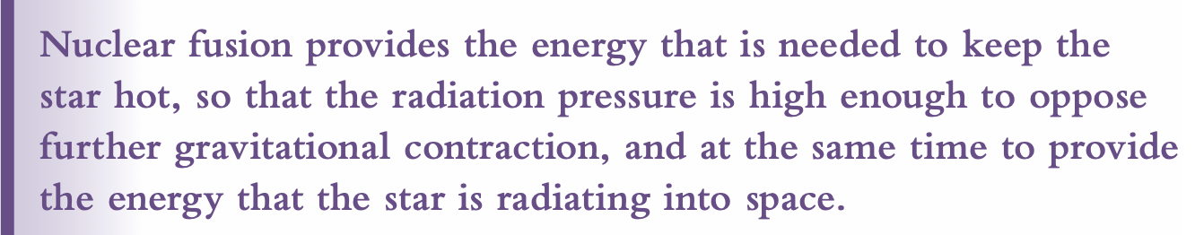
Stars

Slide 26
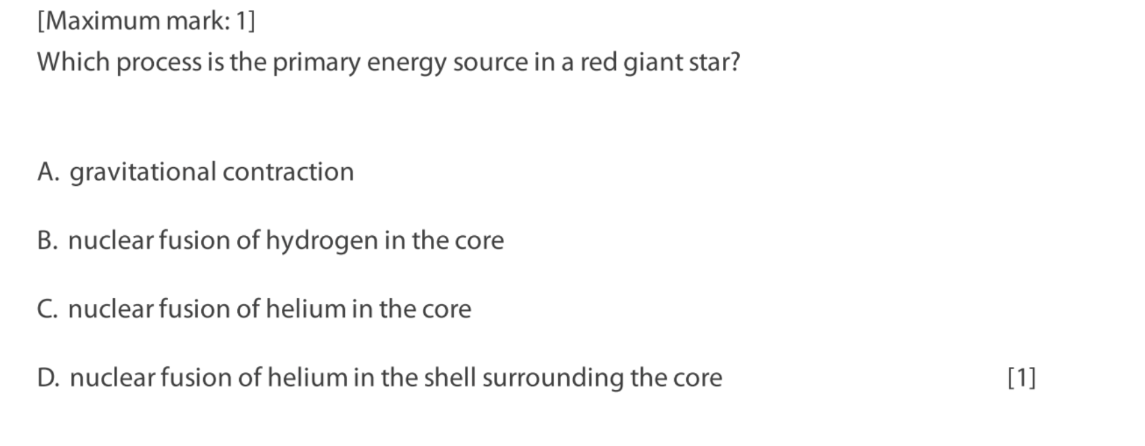

Stars
If done do paper questions E.5: 12 and 17

Slide 27
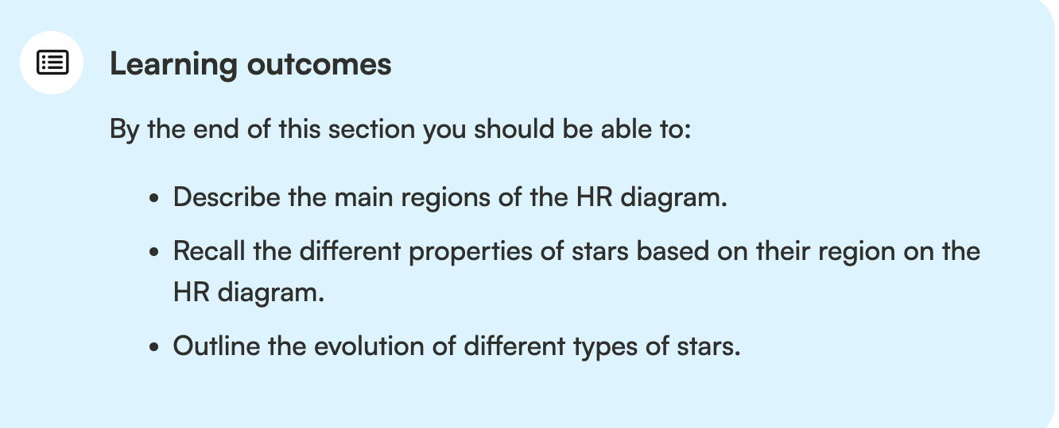
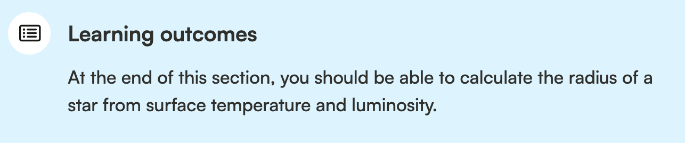
Stars

Slide 28
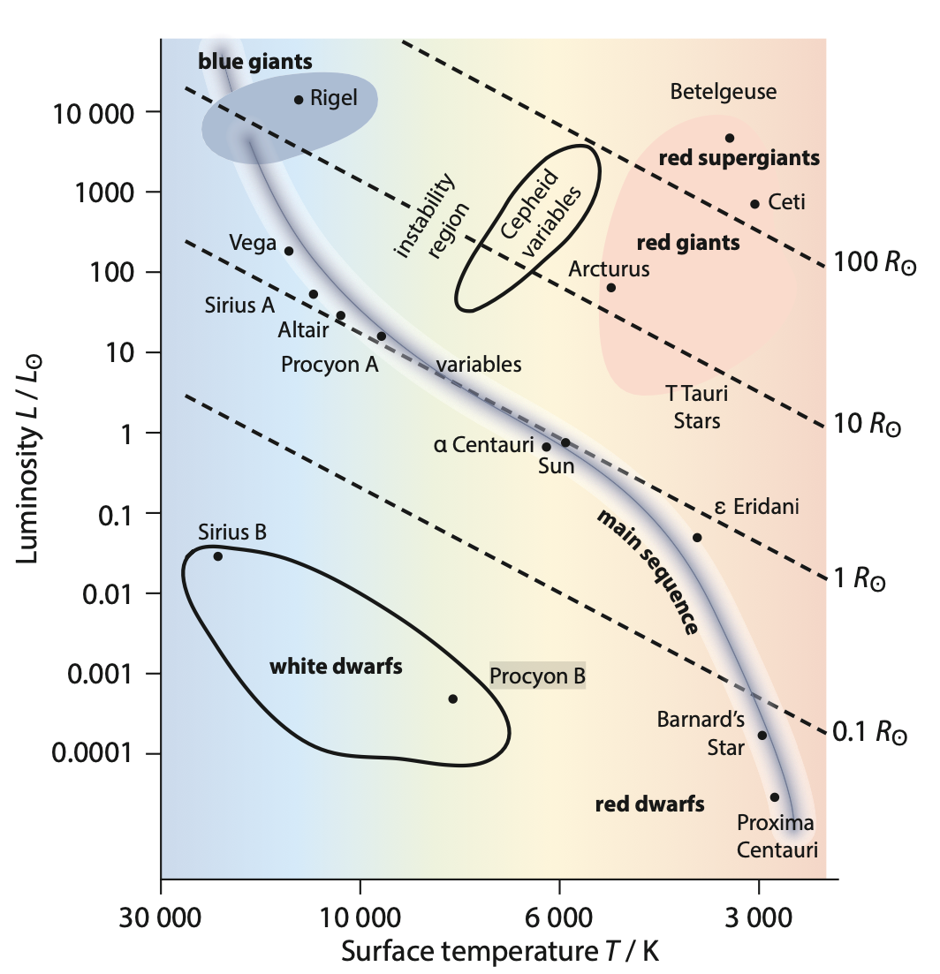
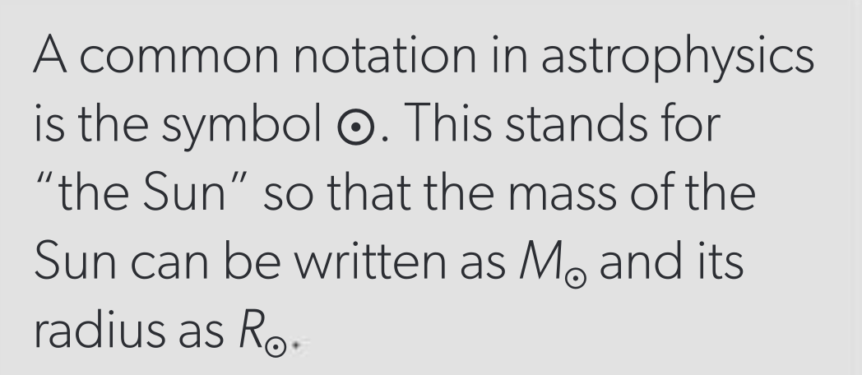
The Hertzprung – Russell Diagram
Relative to Sun’s
luminosity and
temperature
Lowest temperature
on the right
Curved line shows the main sequence stars
Top right shows the red giants and red supergiants
Bottom left shows the dwarfs
Conclusion: more luminous the star is, bigger it is.

Slide 29
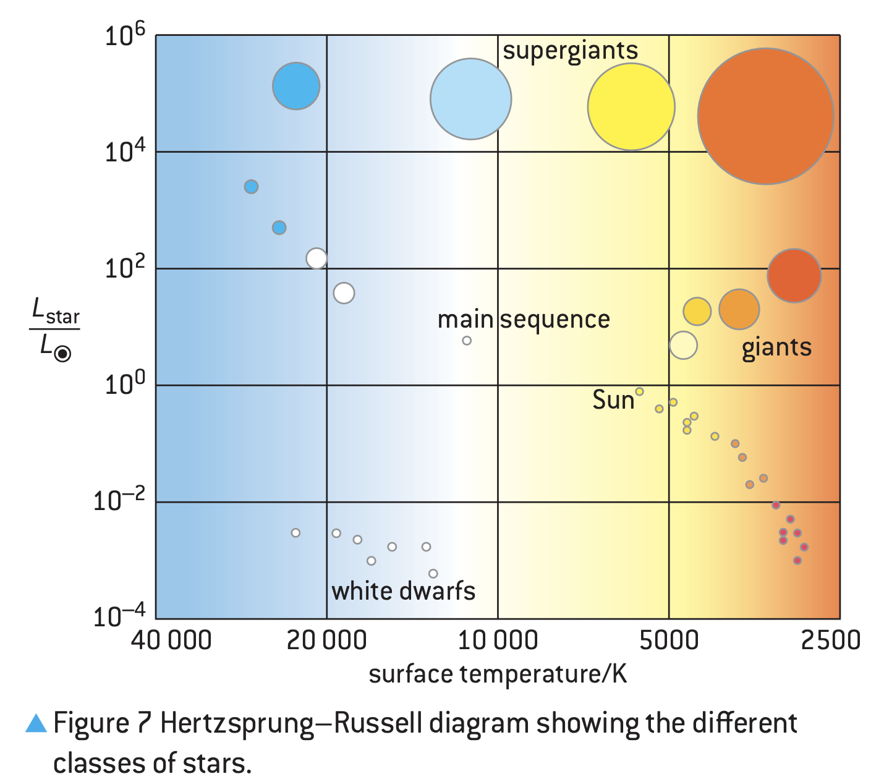
The Hertzprung – Russell Diagram
Main sequence stars: They have fusion of hydrogen and other light nuclei as energy source, like our Sun.
Red giants: They are bigger than main sequence stars, colder and higher in luminosity.
White dwarfs: They are hot but small. They have low luminosity.

Slide 30
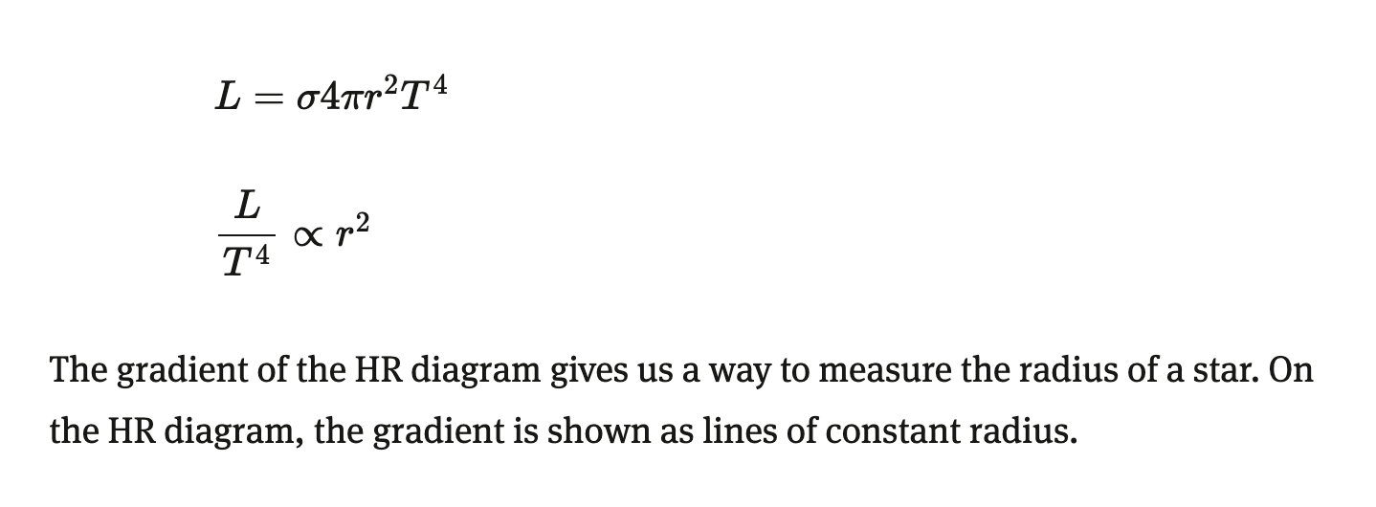
The Hertzprung – Russell Diagram
Red giants: They are bigger than main sequence stars, colder and higher in luminosity.
White dwarfs: They are hot but small. They have low luminosity.

Slide 31
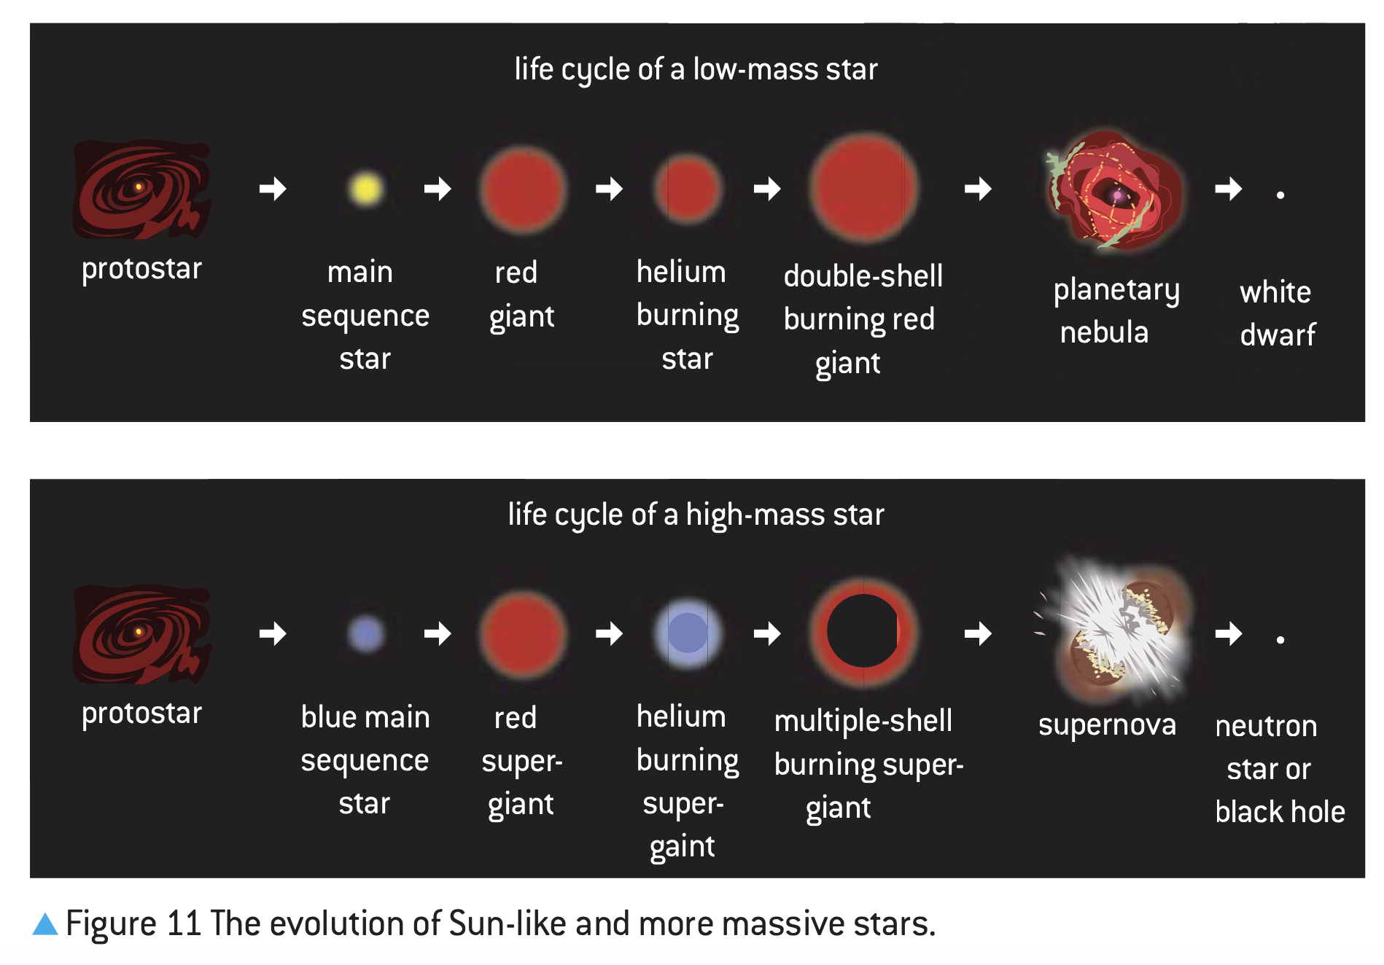
Stellar Evolution (klik!)

Slide 32
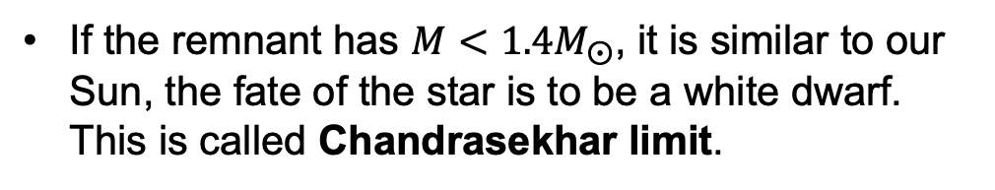
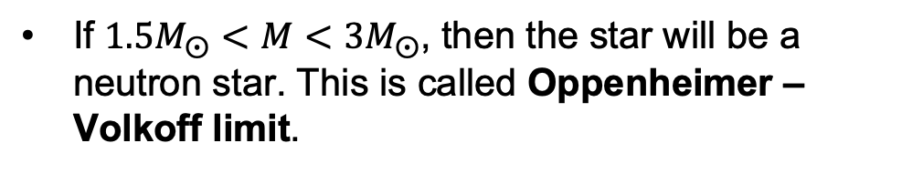
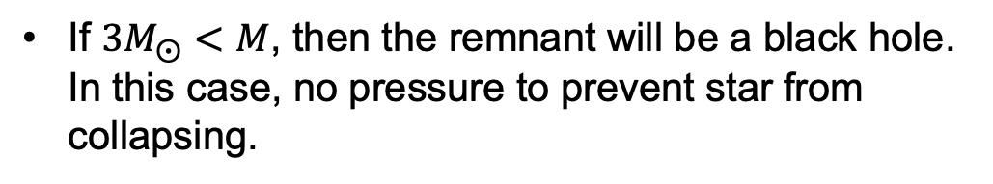
Stellar Evolution

Slide 33
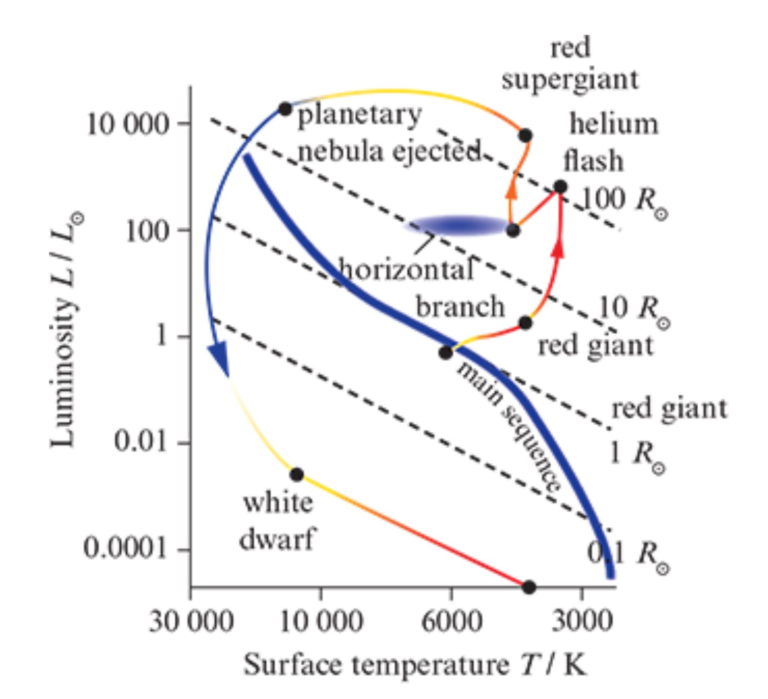
Stellar Evolution

Slide 34
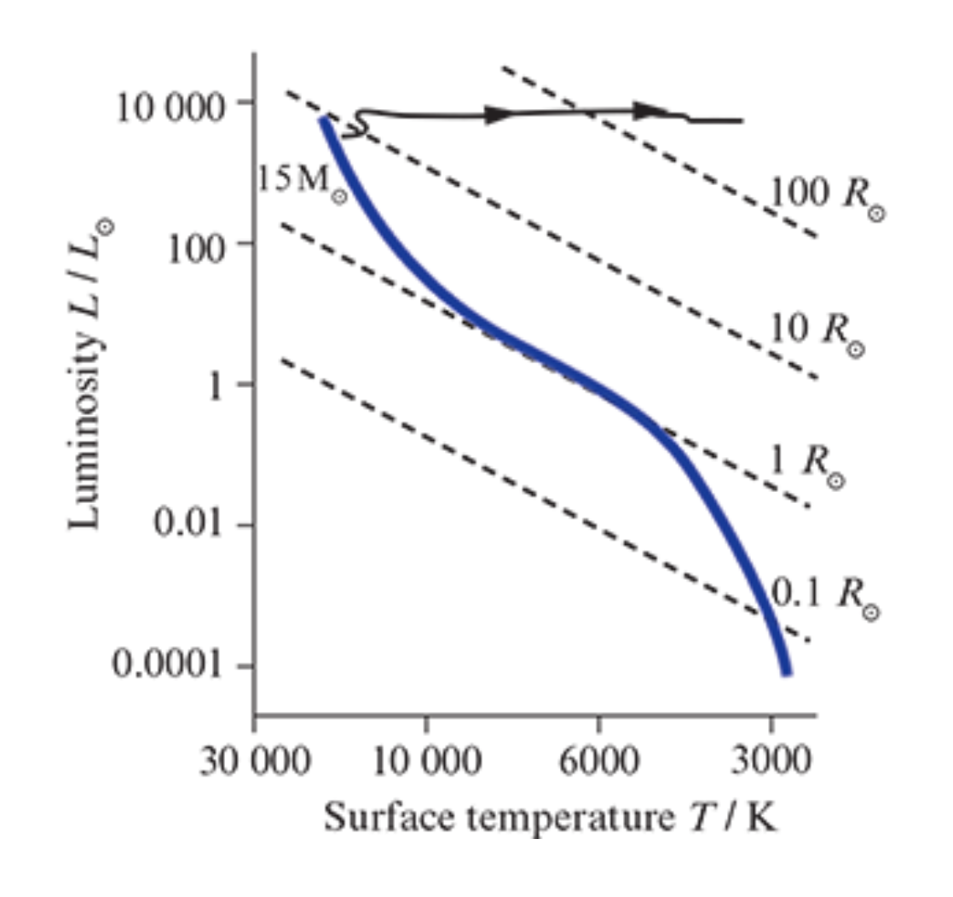
Stellar Evolution

Slide 35
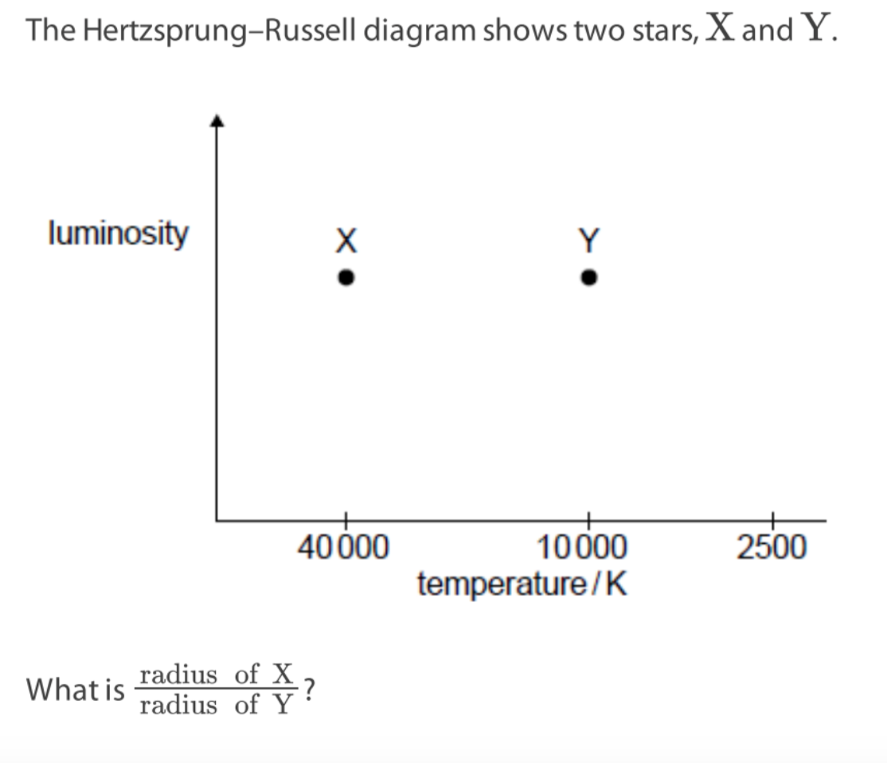
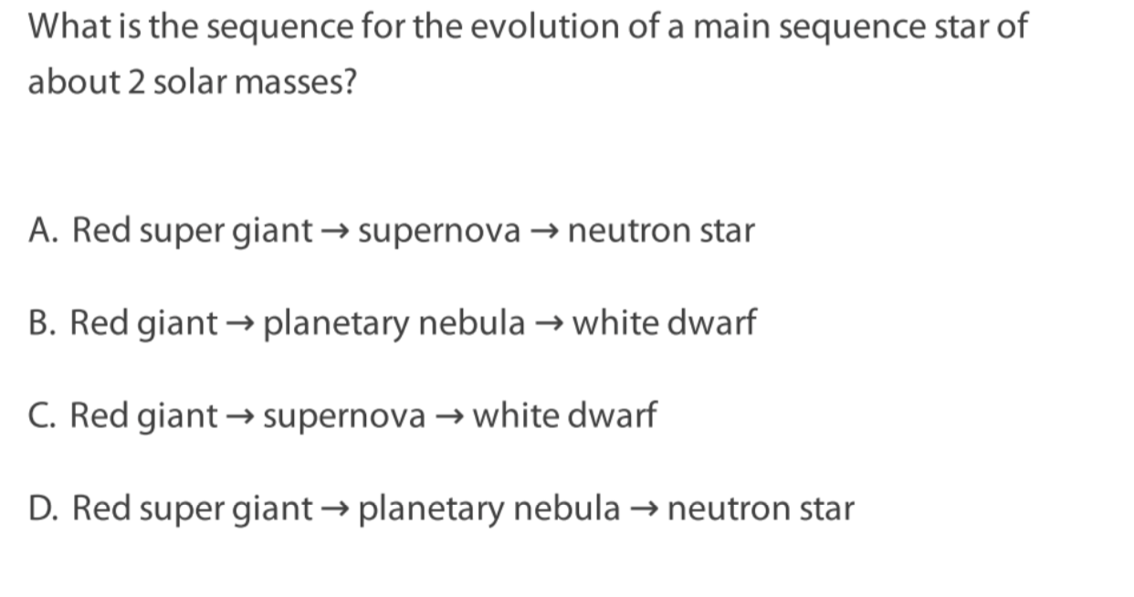
If done do paper questions E.5: 4,5,10,11

Slide 36
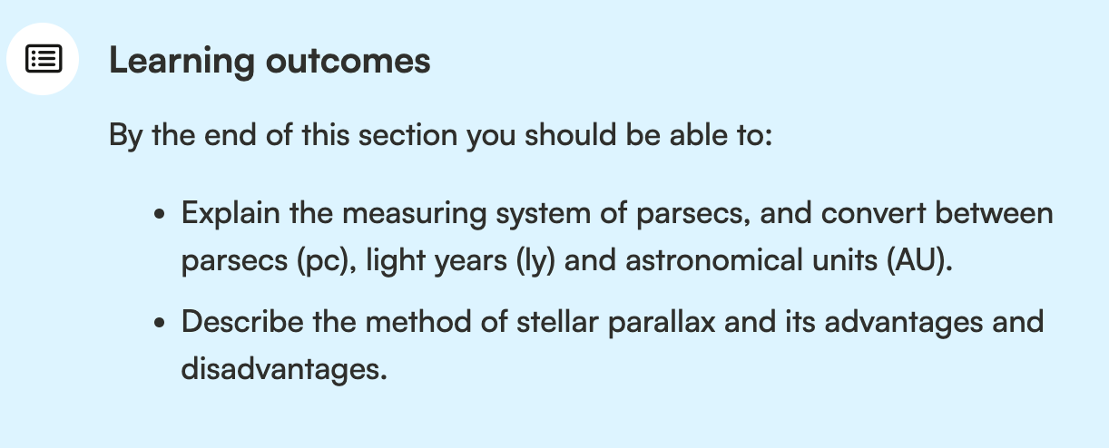
Astronomical Distances

Slide 37
Astronomical Distances
Quantity | Definition | Symbol | Equivalent/m
Light year | The distance travelled by light in one year | ly
Astronomical Unit | The average distance between the Sun and the Earth. | AU
Parsec | The unit for expressing the distance between stars and galaxies. | pc

Slide 38
Astronomical Distances
200 nAU = ….. parsec
0.00002 ly = ….. TAU
Use your booklet to convert!

Slide 39
Parallax Method and its Limitations
Stellar Parallax is a method to measure astronomical distances, and it has limitations.

Slide 40
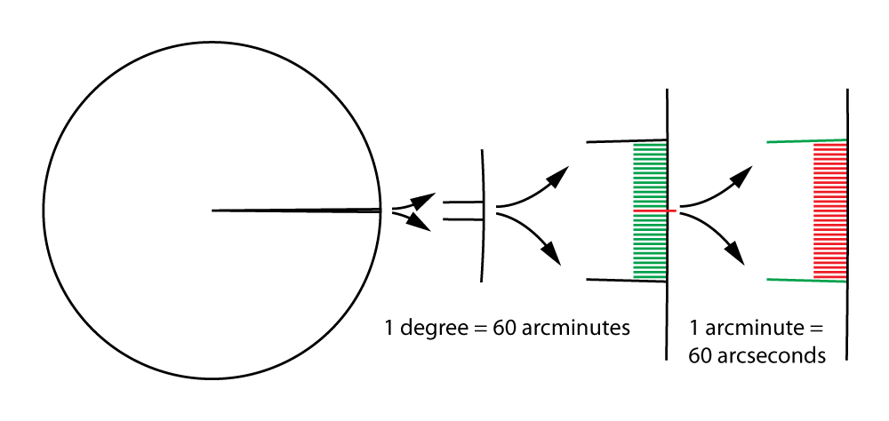
Parallax Method
small angle, how small?

Slide 41
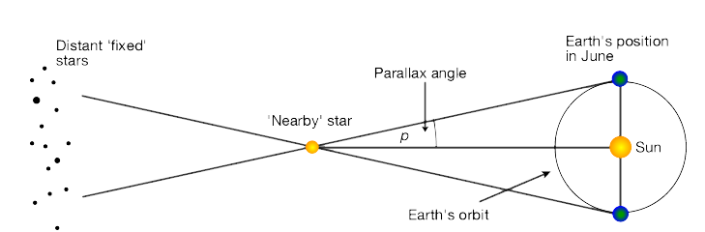
Parallax Method

Slide 42

Parallax Method
June
December

Slide 43
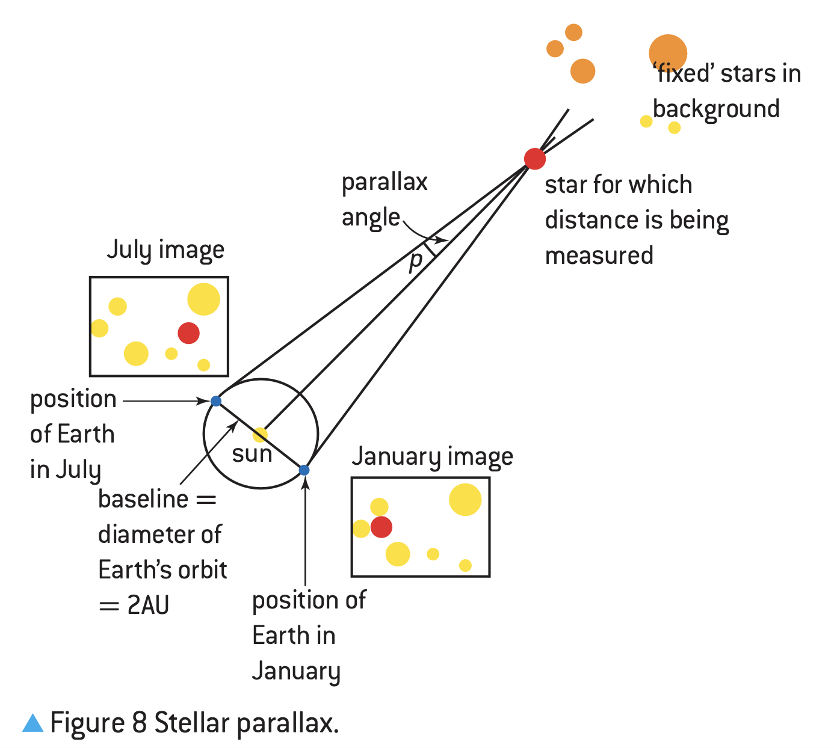
Parallax Method

Slide 44
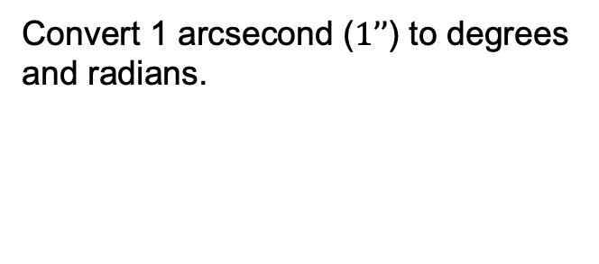
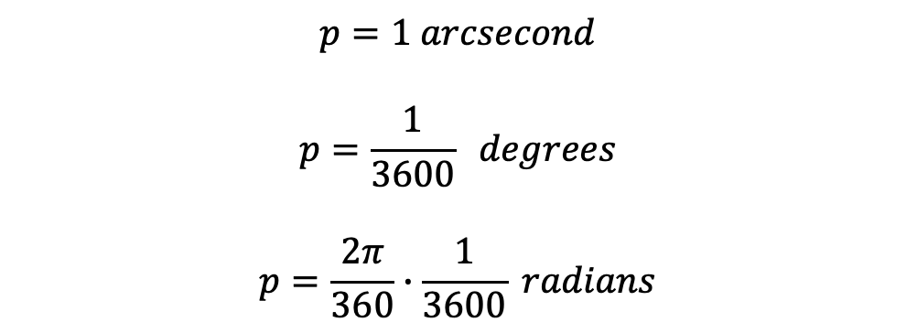
Parallax Method
p
d

Slide 45
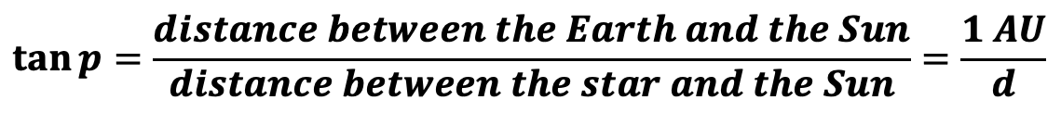
Parallax Method

Slide 46
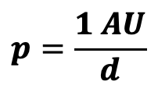
Parallax Method
NOT IN THE DATABOOKLET
in radian!

Slide 47
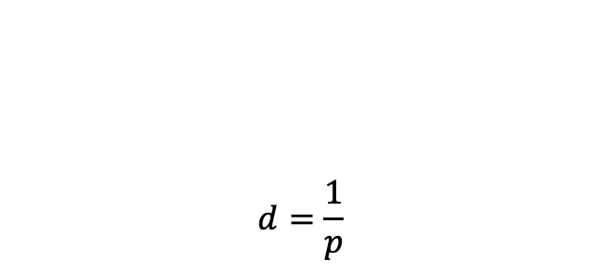
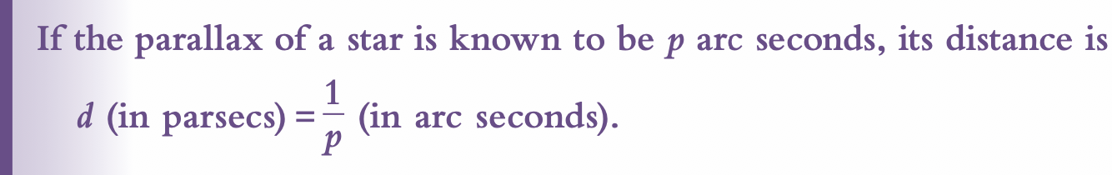
Parallax Method
in parsec!
in arcsecond!
p
d

Slide 48
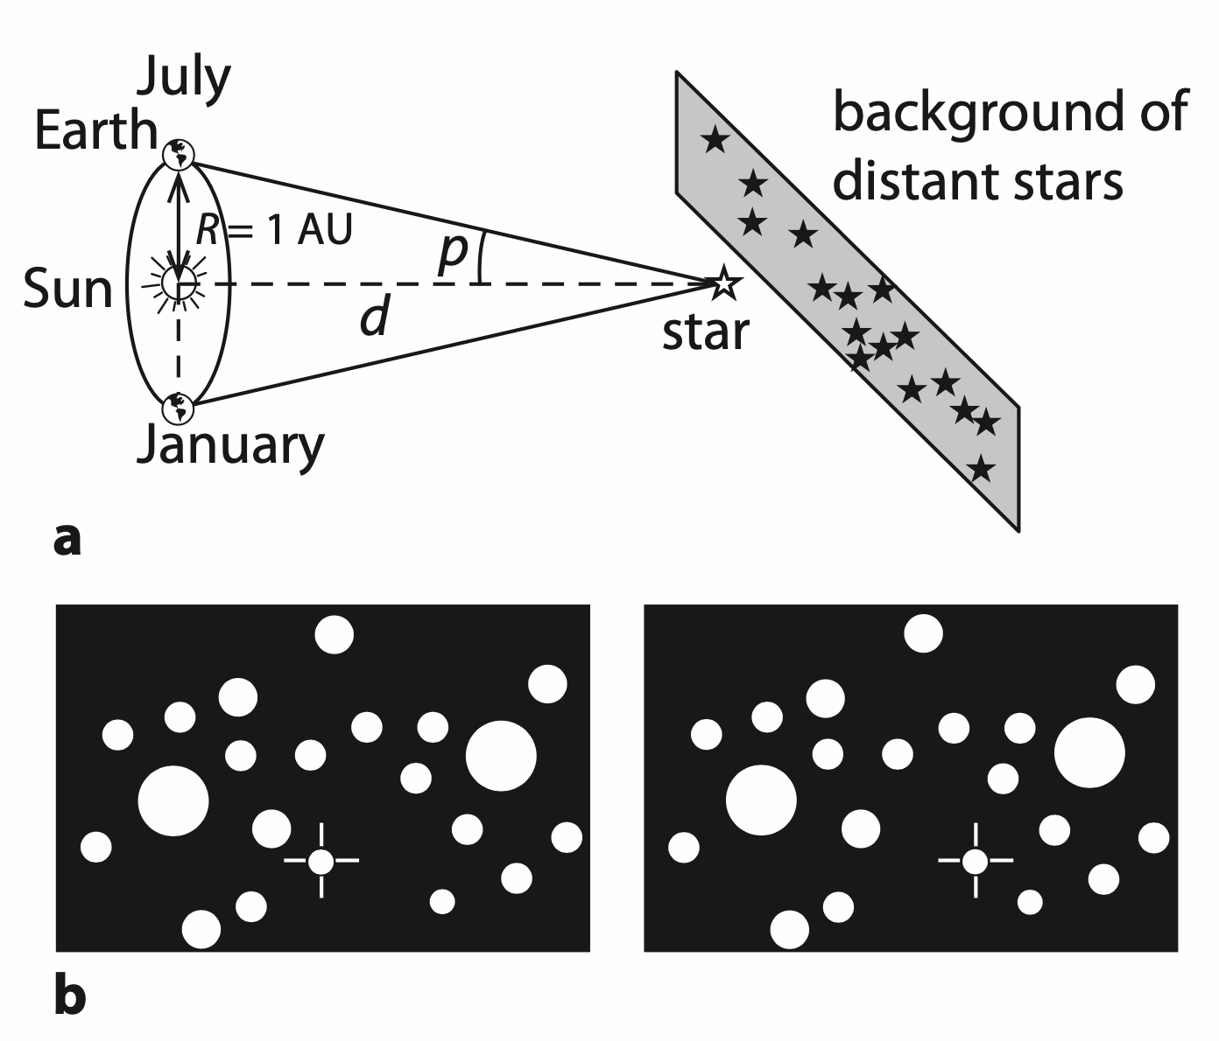
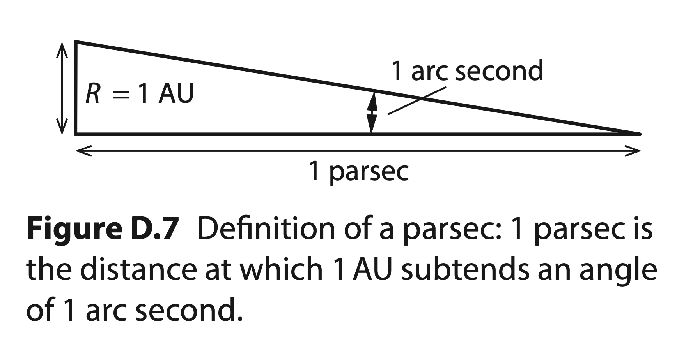
Parallax Method

Slide 49
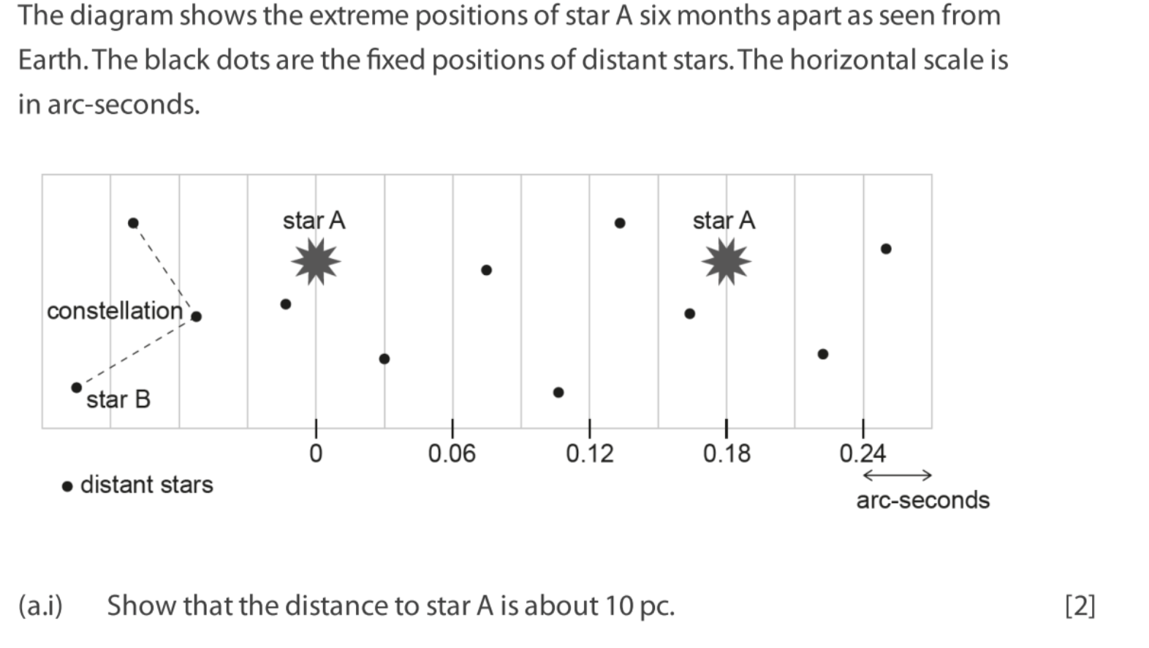

Parallax Method
Paper question E.5: 9

